Slide 1


Difficulty Analysis of Sudoku Puzzle
Supervisor :
Abu Wasif
Asst Prof, Dept of CSE, BUET
Team Members (Grp-B16) :
Muhammad Zubair Hasan (201714041)
Shariar Azad (201714037)
Nazifa Hamid (201714044)

Slide 2
Broad Area of Research
Artificial intelligence (AI) is intelligence demonstrated by machines, unlike the natural intelligence displayed by humans and animals.​
In AI, Constraint satisfaction problem (CSP) are mathematical questions defined as a set of objects whose state must satisfy a number of constraints or limitations.​
Sudoku is a puzzle invented in Japan and it can be solved using CSPs.​
There are also more efficient ways to solve sudoku using search based , logic based and computational based algorithms.​
A lot people daily solve sudoku of different difficulty on various websites.​
The science behind the difficulty of the sudoku puzzle is truly fascinating.

Slide 3
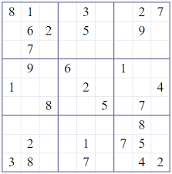
Introduction
Sudoku is a puzzle that consists of a 9 x 9 grid partially filled with numbers from 1-9.
Sudoku is considered as a Constraint satisfaction problem where Variable : each cell, Domain: 1 to 9, Constraints: AllDiff (each row, each column, each box).
Generally used difficulty scales of sudoku puzzles are Easy, Medium, and Hard.
In this thesis, difficulty of sudoku puzzles were analyzed with respect to various parameters.

Slide 4
Literature Review
Literature | Year of Publication | Algorithms Used | Main Idea
A to Z of Sudoku by Narendra Jussien | 2007 | Single position, single candidate, hidden singles, naked pair &triples , hidden pair & triples, X-Wing, Swordfish | This book discusses difficulty rating and human like solving methods
Taking Sudoku Seriously by Jason Rosenhouse et al | 2011 | Search based and logic-based algorithms | This book discusses various sudoku difficulty properties
There is no 16-Clue Sudoku: Solving the Sudoku Minimum Number of Clues Problem | 2014 | Open-source solver BBSudoku which contains almost all human like sudoku solving algorithms | This paper proves that there is no valid 16-clue puzzle by performing exhaustive computer search and describes the method as well as the search
Difficulty Rating of Sudoku Puzzles: An Overview and Evaluation by Radek Pelanek | 2011 | Backtracking, Hidden single, Direct Pointing, Direct Claiming, Direct Hidden Pair, Naked Single, Direct Hidden Triple, Pointing, Claiming | This paper describes and evaluates techniques for predicting human sudoku solving behavior, particularly for difficulty rating of puzzles and for predicting the order of cell filling.
A Scale to Measure the Difficulty of Sudoku Puzzles by José Silva Coelho | 2007 | Solved as a SAT problem | This paper presents a PnP (paper-and-pencil) method to solve and measure the degree of difficulty of Sudoku puzzles. Contrary to other methods, this method can classify the puzzles automatically without human intervention.

Slide 5
Objectives
To study human solving techniques of sudoku puzzles
To implement logic and search-based algorithms
To study features of sudoku boards
To find correlation between features and hardness

Slide 6
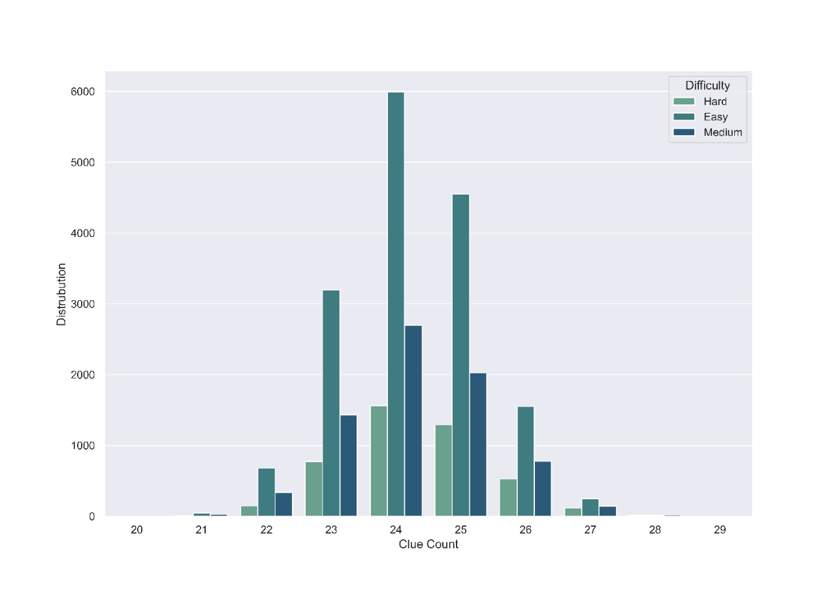
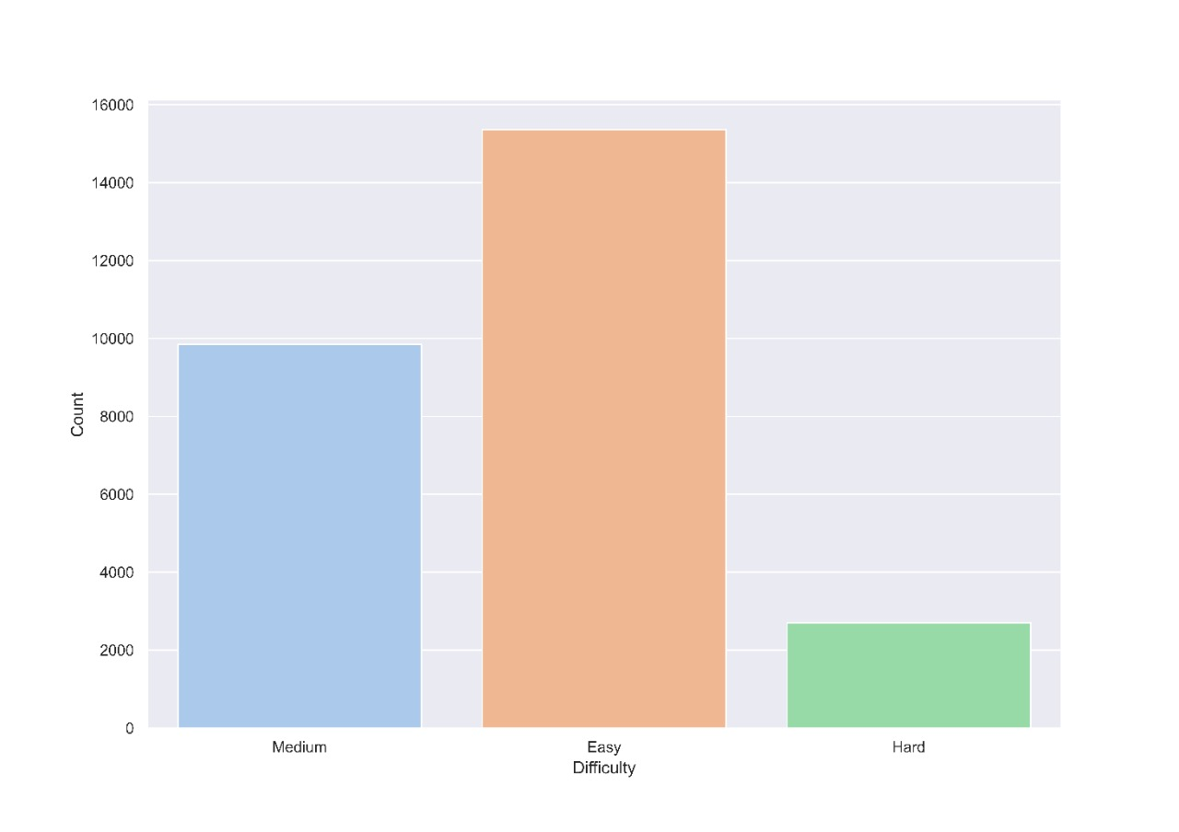
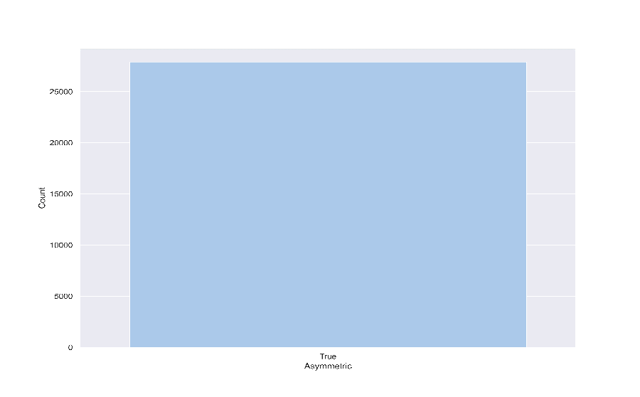
Dataset
Gordon Royle’s “17 clue” dataset which contains 49,157 sudoku puzzles
3 millions sudoku puzzles generated by Blagovest Dachev’s sudoku generator from kaggle
17 clue dataset
Empty Region Size | Count
6 | 865
8 | 5612
9 | 6933
10 | 6592
12 | 5801
14 | 622
15 | 593
16 | 313
18 | 84
17 clue dataset
Difficulty | Count
Easy | 15850
Medium | 7254
Hard | 4311
3 million sudoku dataset
Empty Region Size | Count
12 | 4747
14 | 16561
15 | 632
16 | 5474
20 | 489
3 million sudoku dataset
Difficulty | Count
Easy | 15358
Medium | 9843
Hard | 2702

Slide 7
Features of Evaluation
Speed
No. of clues
Size of vacant regions
Symmetry : 2-fold , 4-fold, Vertical, Horizontal, Asymmetry

Slide 8
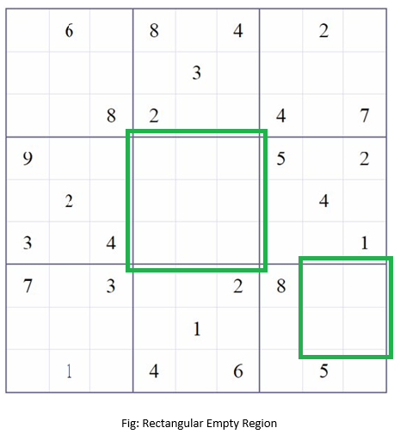
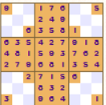
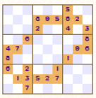
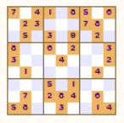
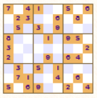
Rectangular Empty Region(Hole) & Symmetry
4-Fold
2-Fold
Asymmetry
Vertical
Horizontal

Slide 9
Methodology
Several experimentation was conducted on both datasets and collected data on features such as difficulty, count , symmetry and region holes in puzzles.
Graphs were generated to find correlations of these parameters with difficulty.

Slide 10
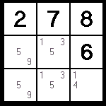
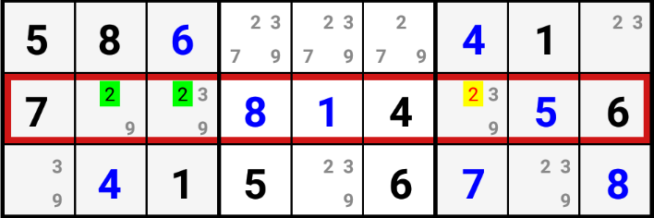
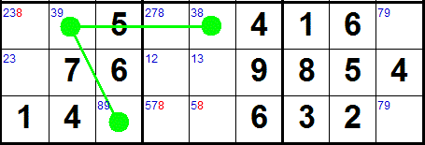
Algorithms
Sudoku logical rules-based algorithms:
Easy Techniques:
Single Candidates
Hidden Singles
Naked Singles
Medium Techniques:
Naked Pair, naked triple, naked quads
Hidden Pair, hidden triple, hidden quads
Pointing Pair
Hard Techniques:
X-wing, XY wing, XYZ wing
Swordfish
Single Chains
Search based algorithm: Brute Force
Hidden Singles
Pointing Pair
XY-Wing

Slide 11
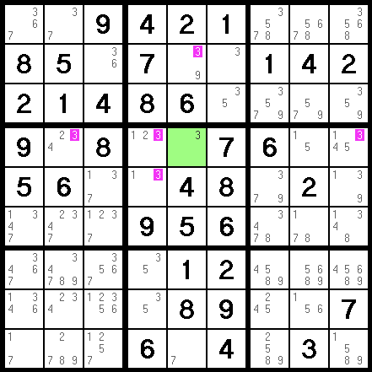
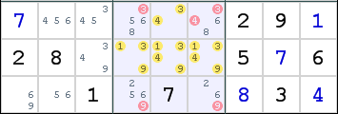
Algorithms
Naked Quads
Single Candidate

Slide 12
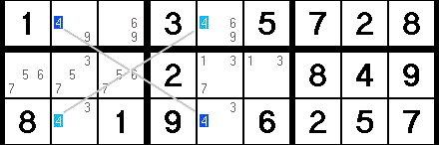
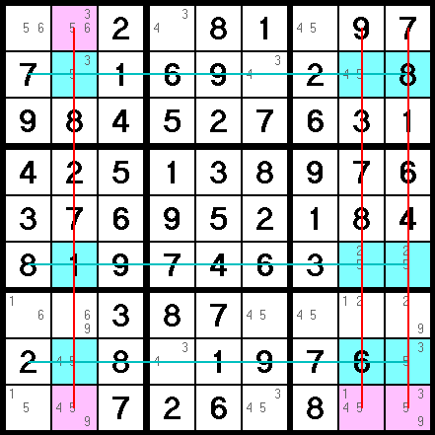
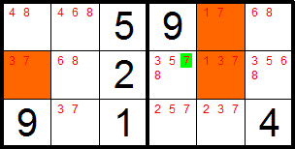
Algorithms
X-wing
XY-wing
XYZ-wing
Swordfish

Slide 13
Algorithms
Brute force
Backtracking (DFS)
Visits cells in some order, fills digits sequentially.
Backtracks when not valid.

Slide 14
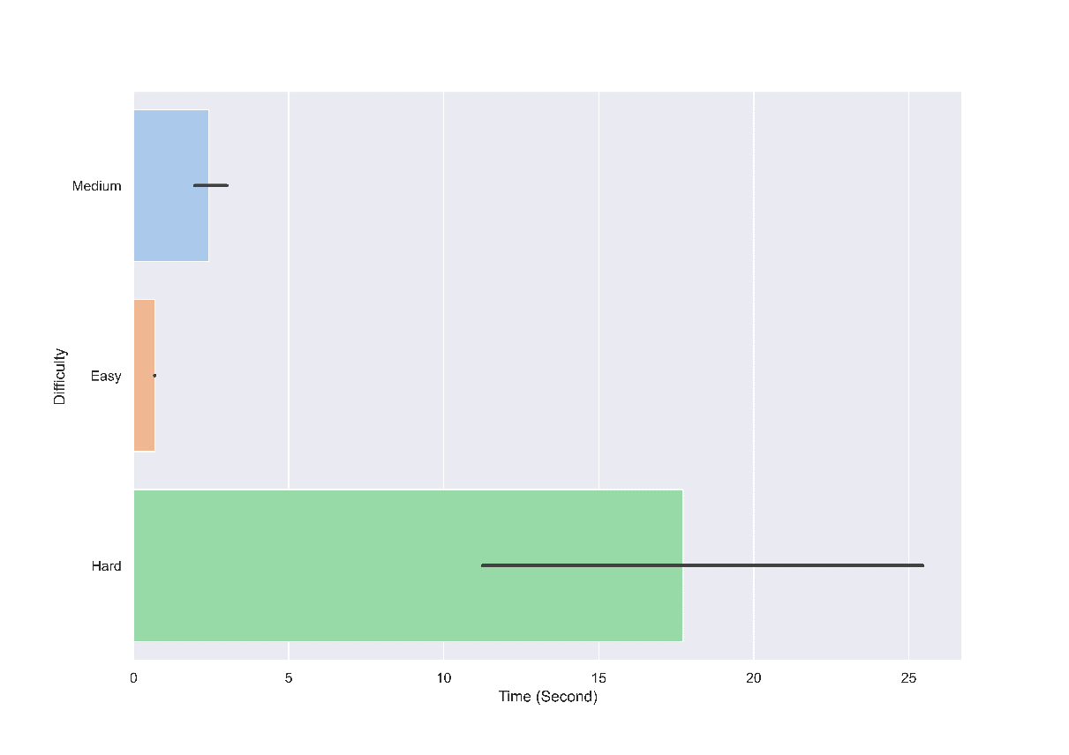
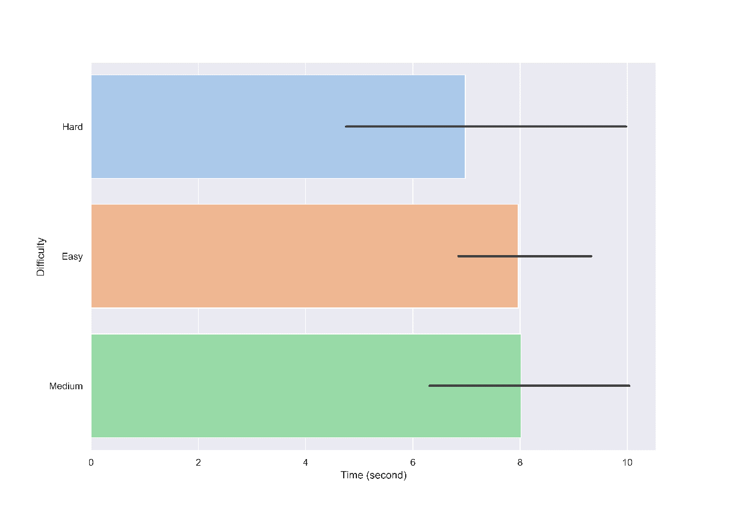
Why Choose Logic Based Algorithm?
Logic based methods take much less time to solve easy and medium puzzles
Brute force takes more and almost equal time for all puzzles.
Logic based algorithm
Search based algorithm (Brute Force)

Slide 15
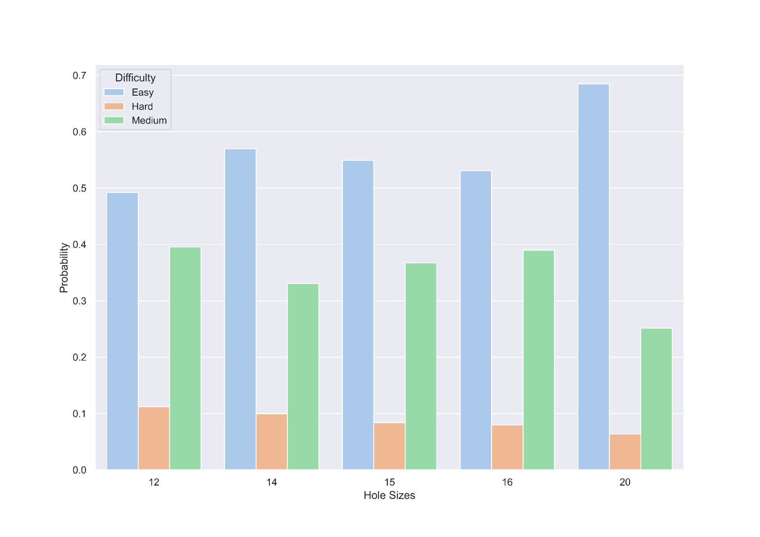
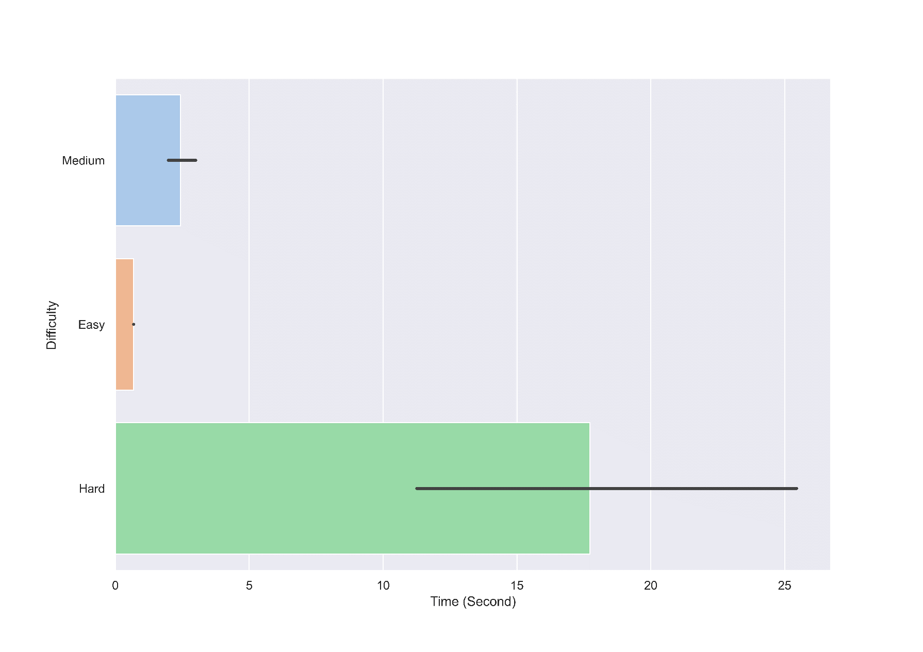
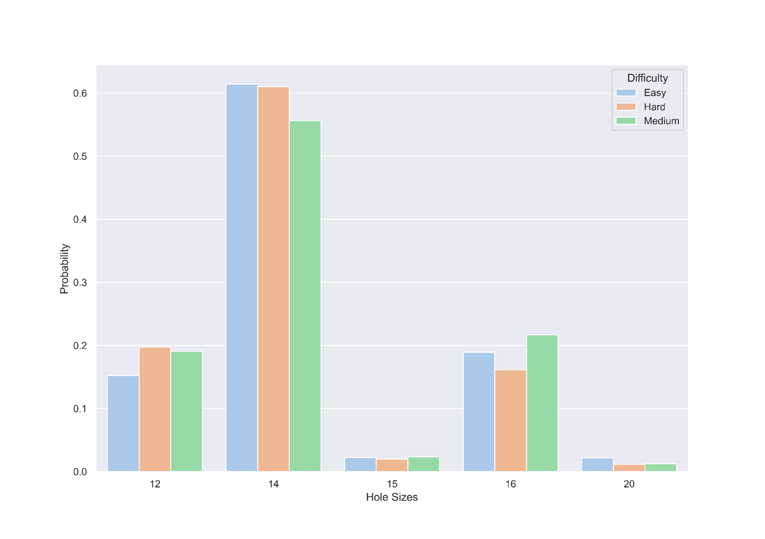
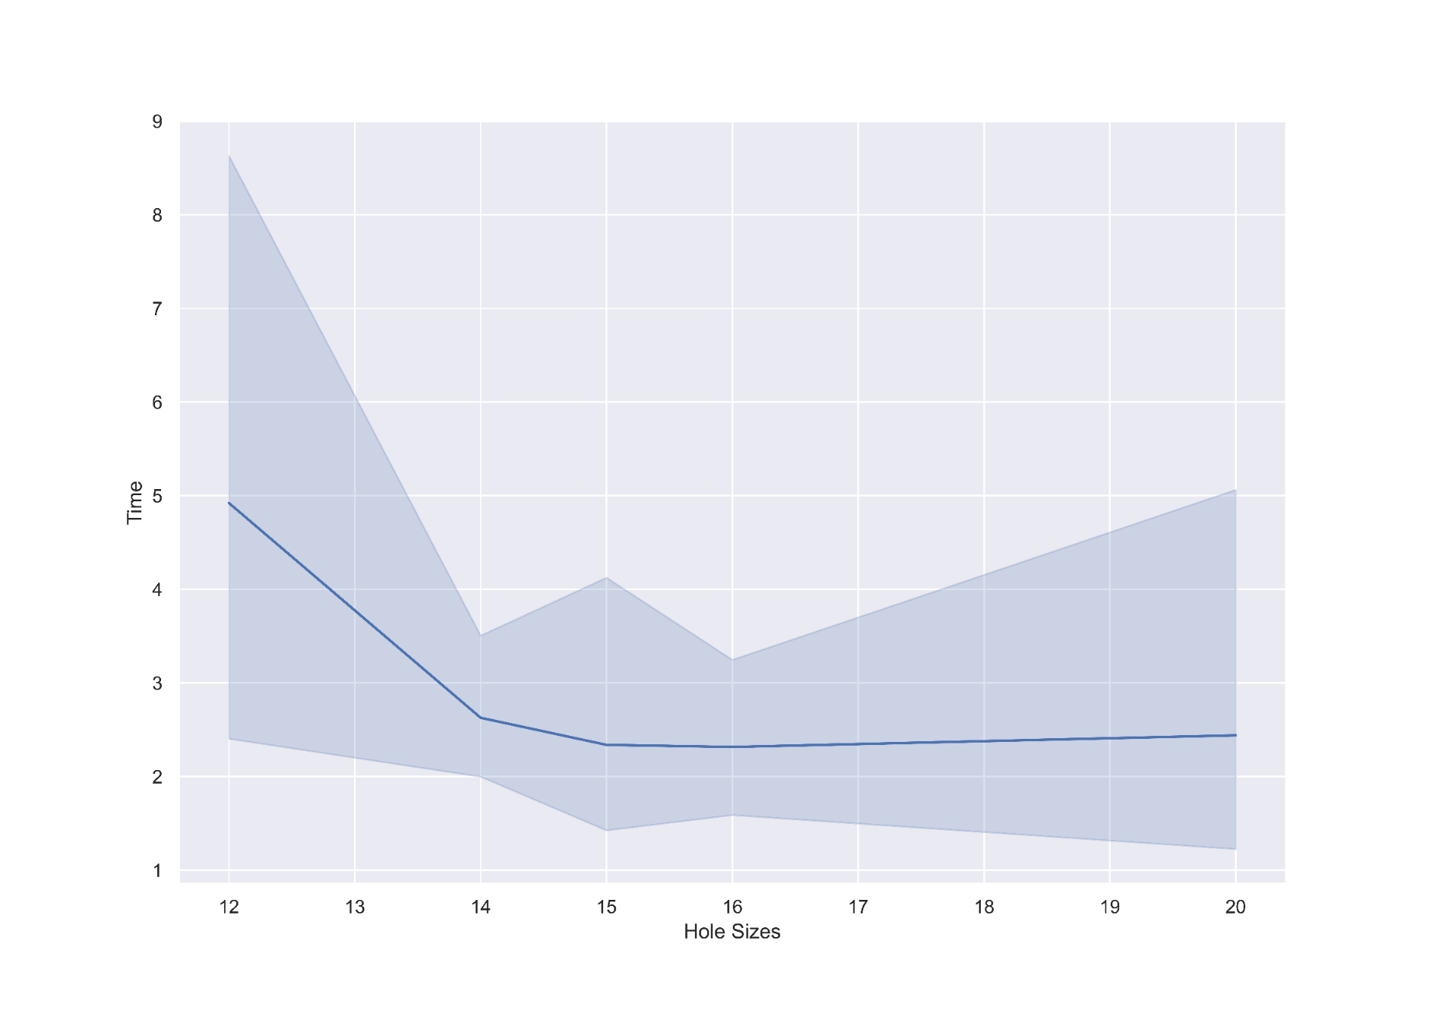
Results (17 Clue Dataset)

Slide 16
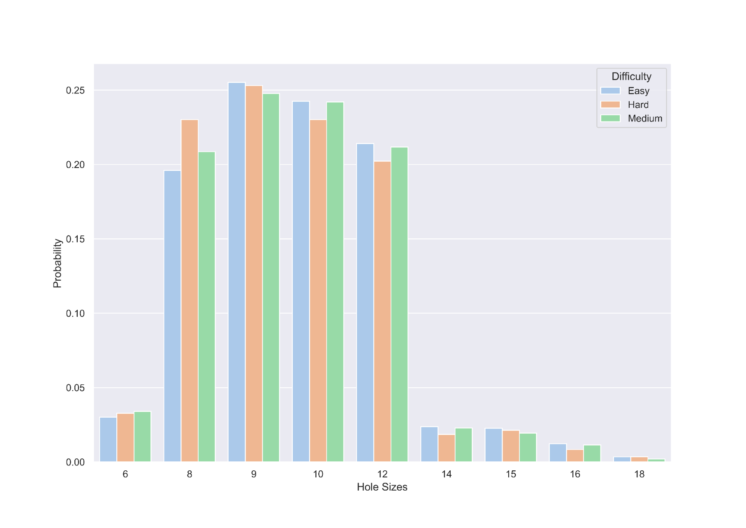
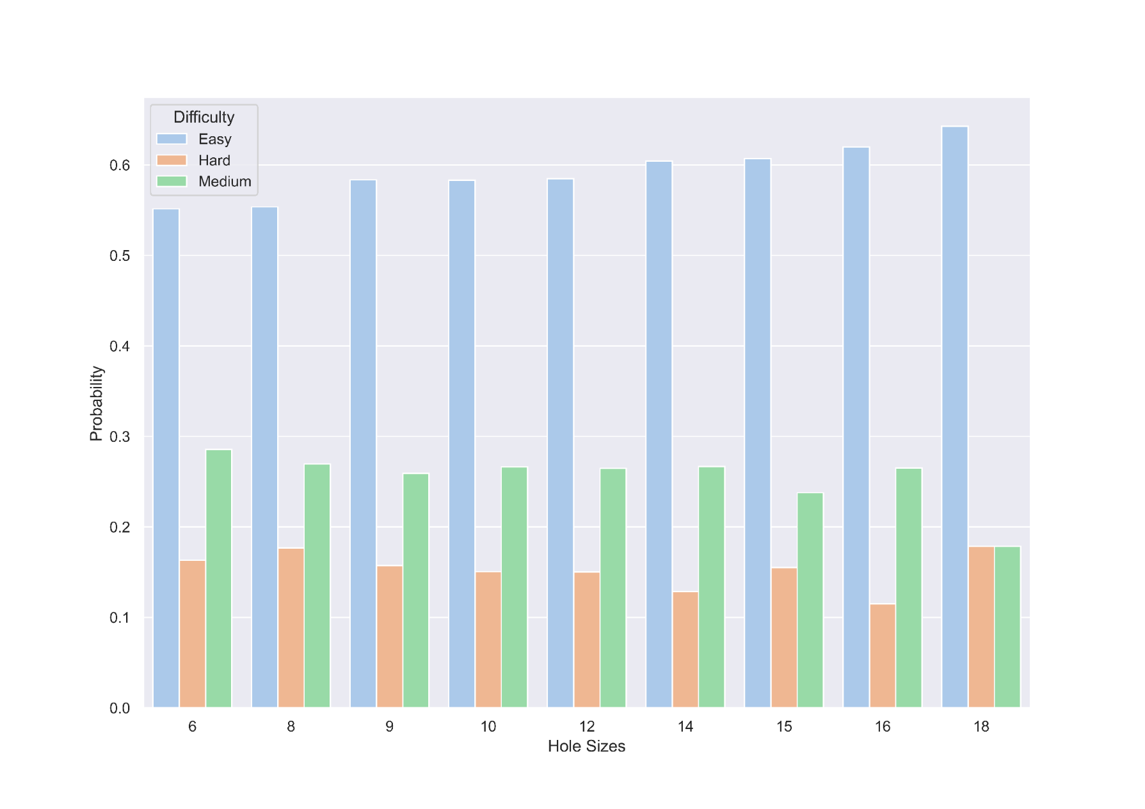
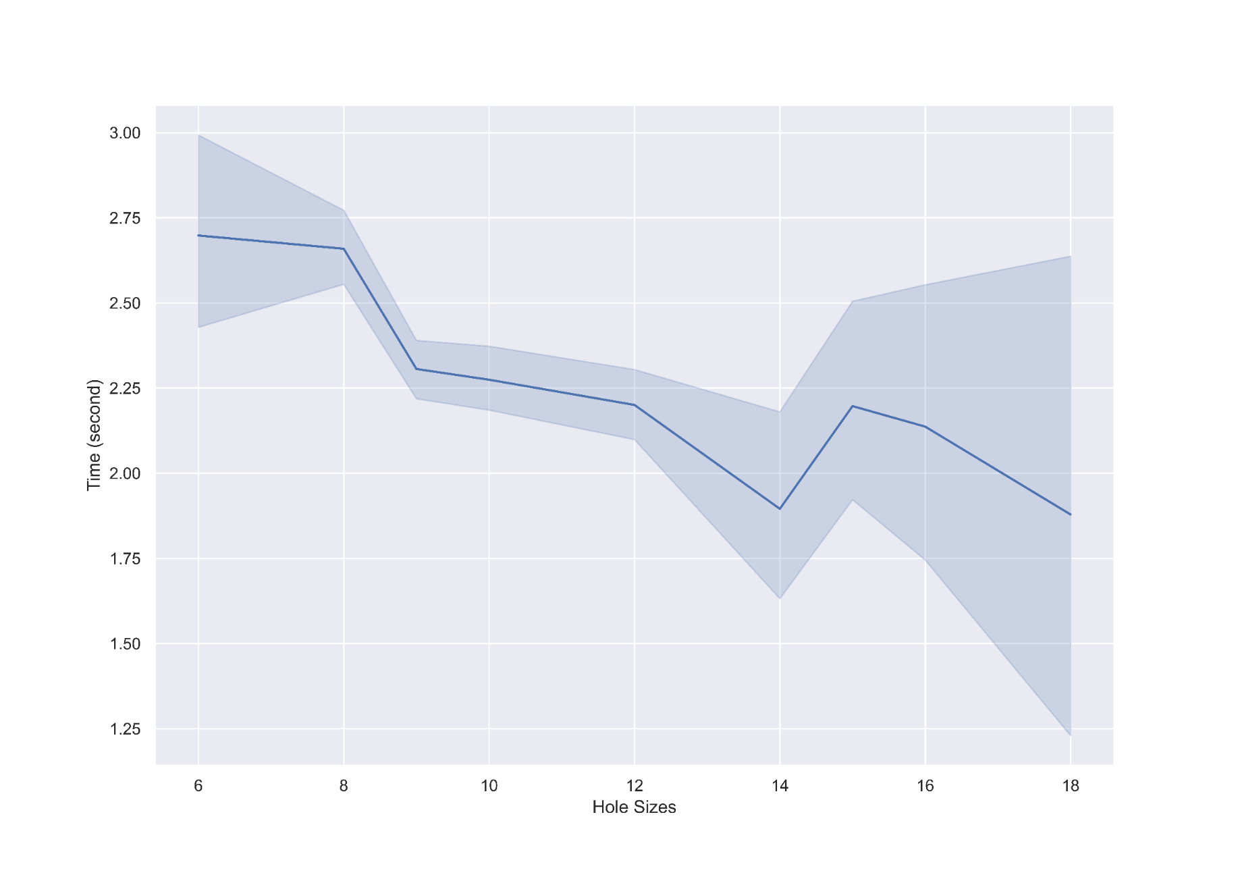
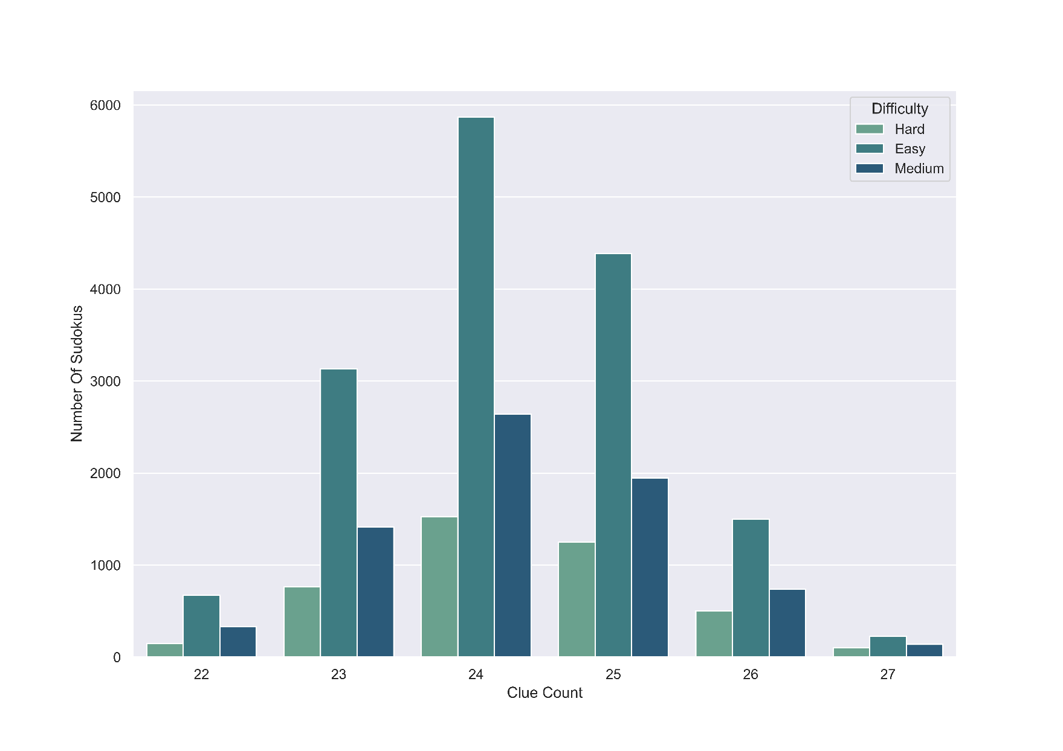
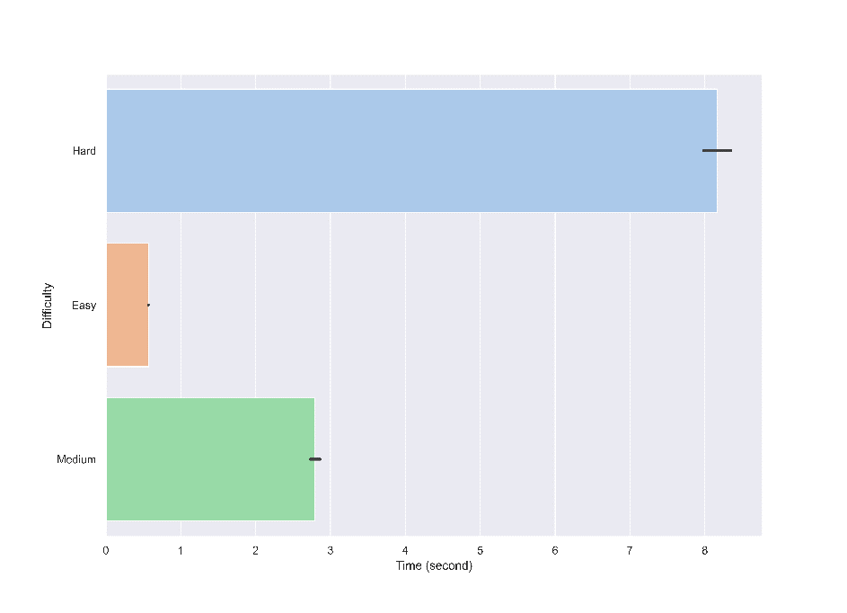
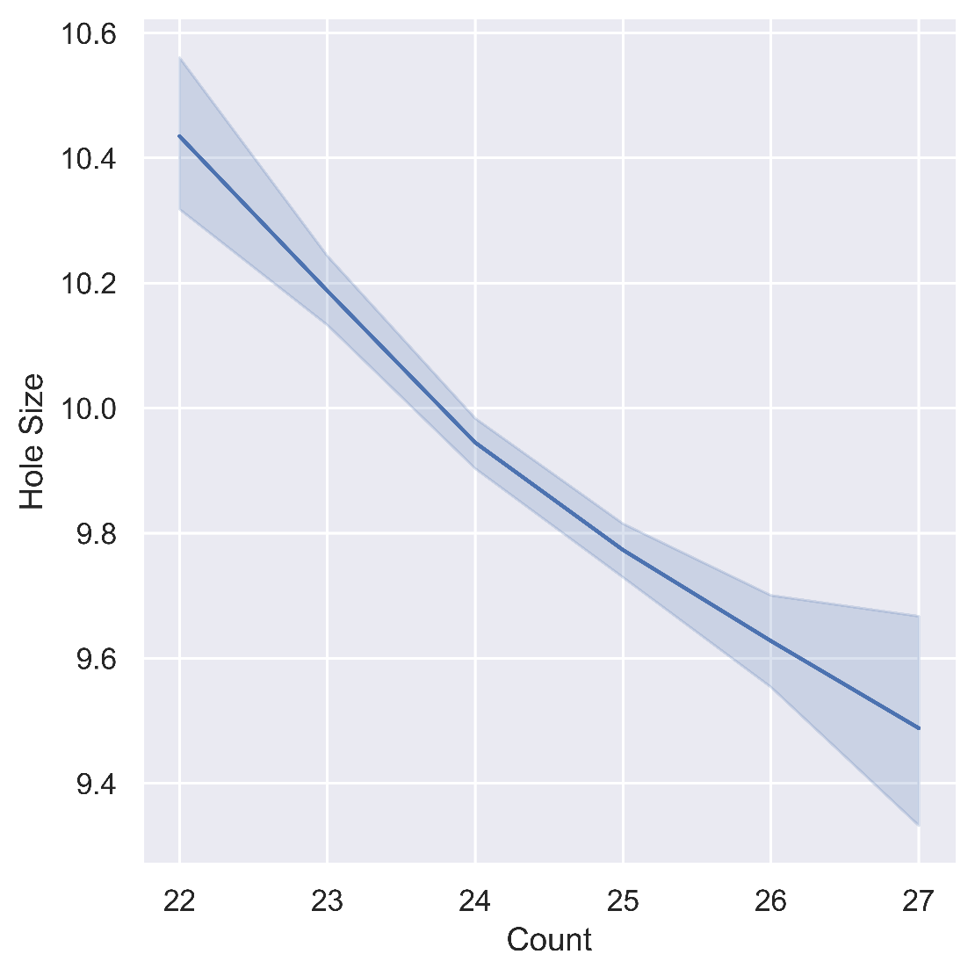
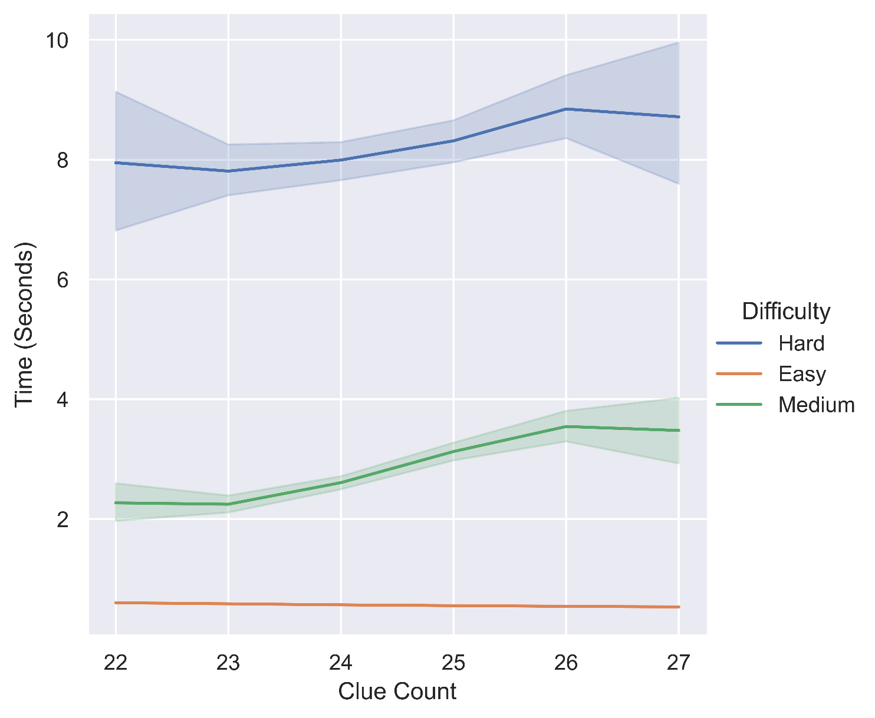
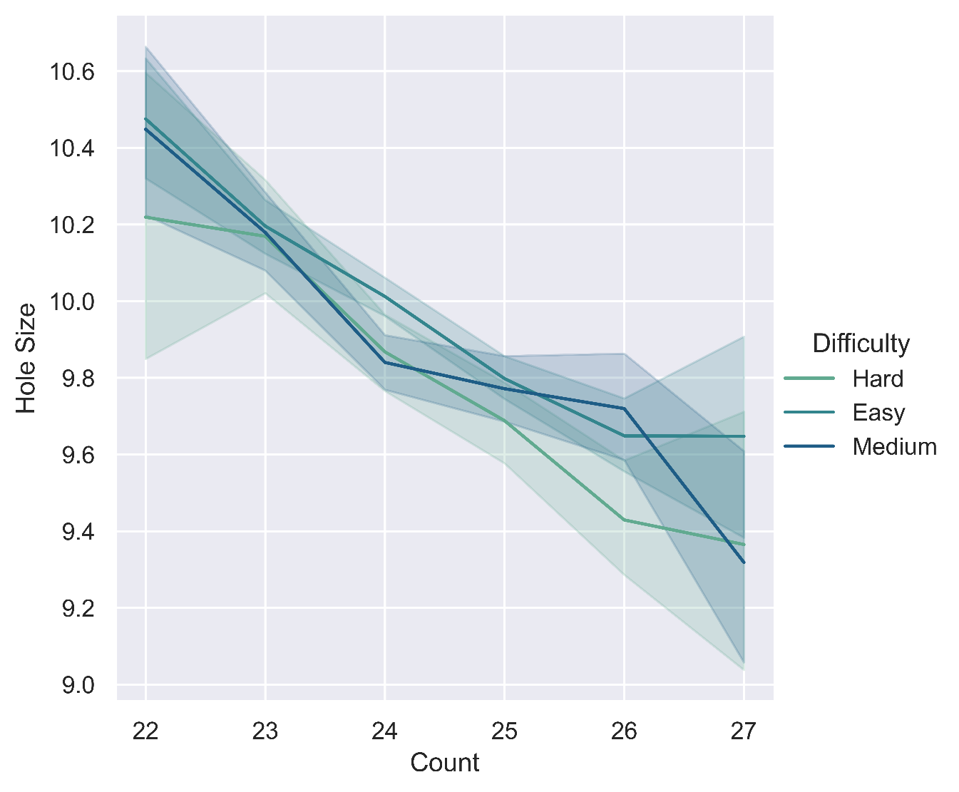
Results (Variable Clue Dataset)

Slide 17
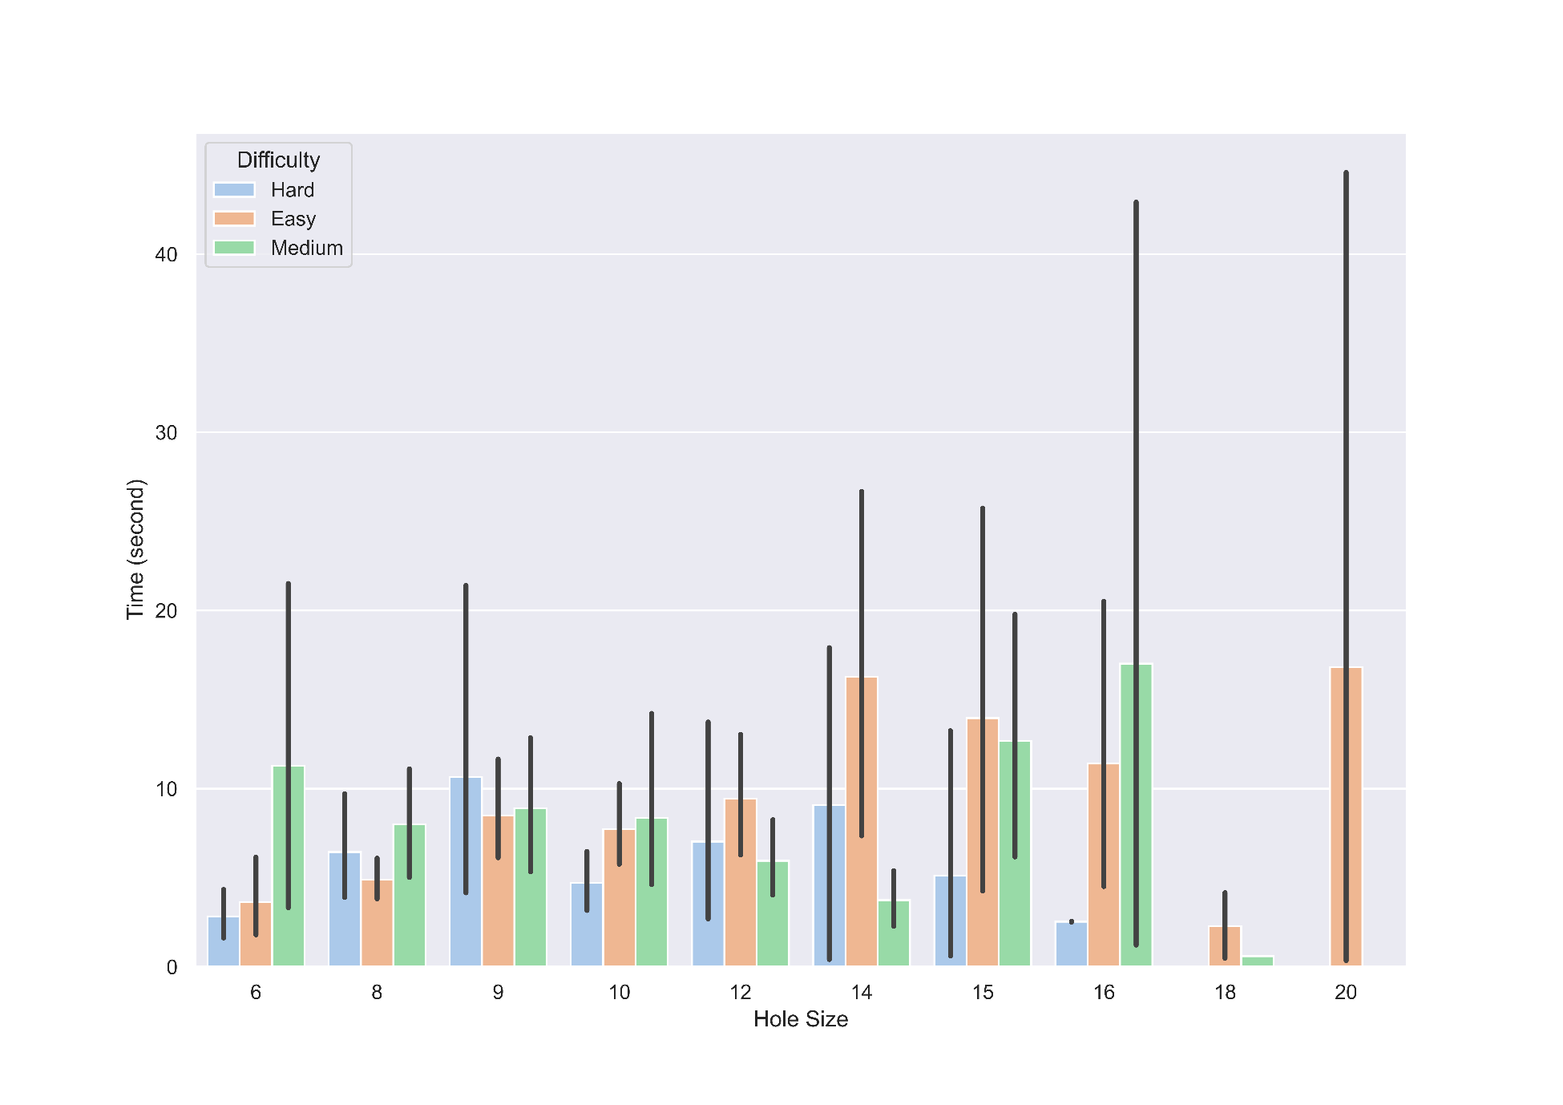
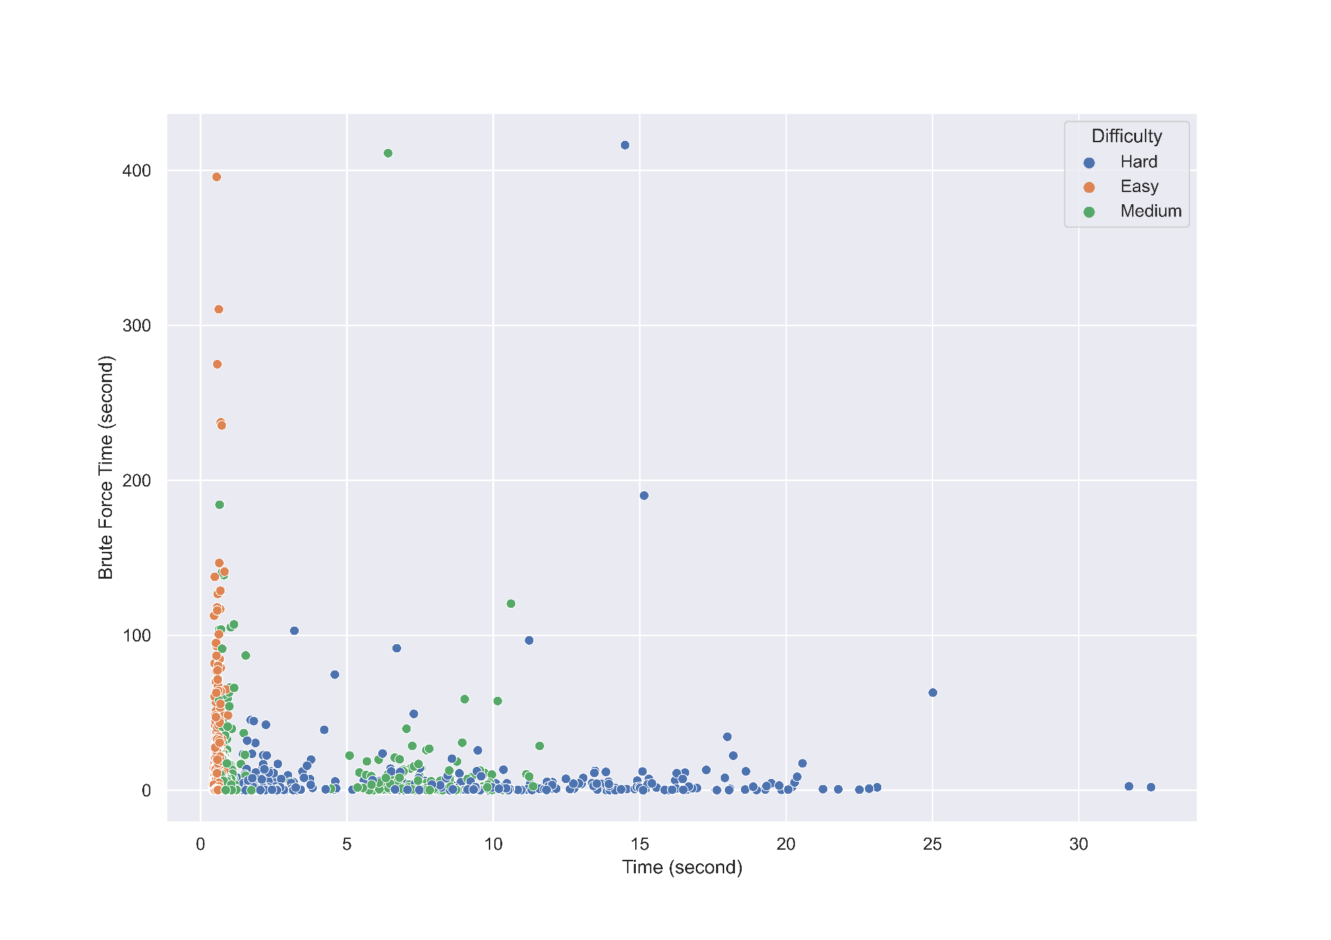
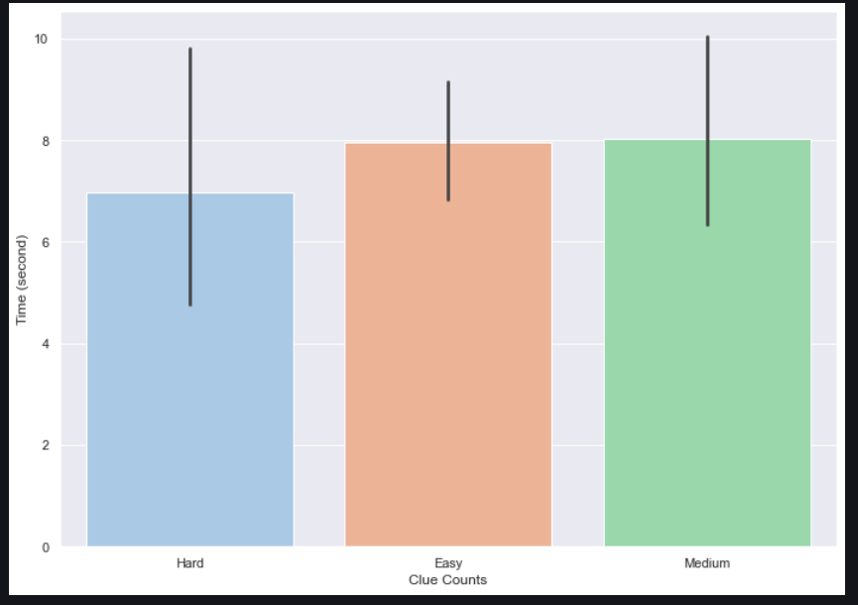
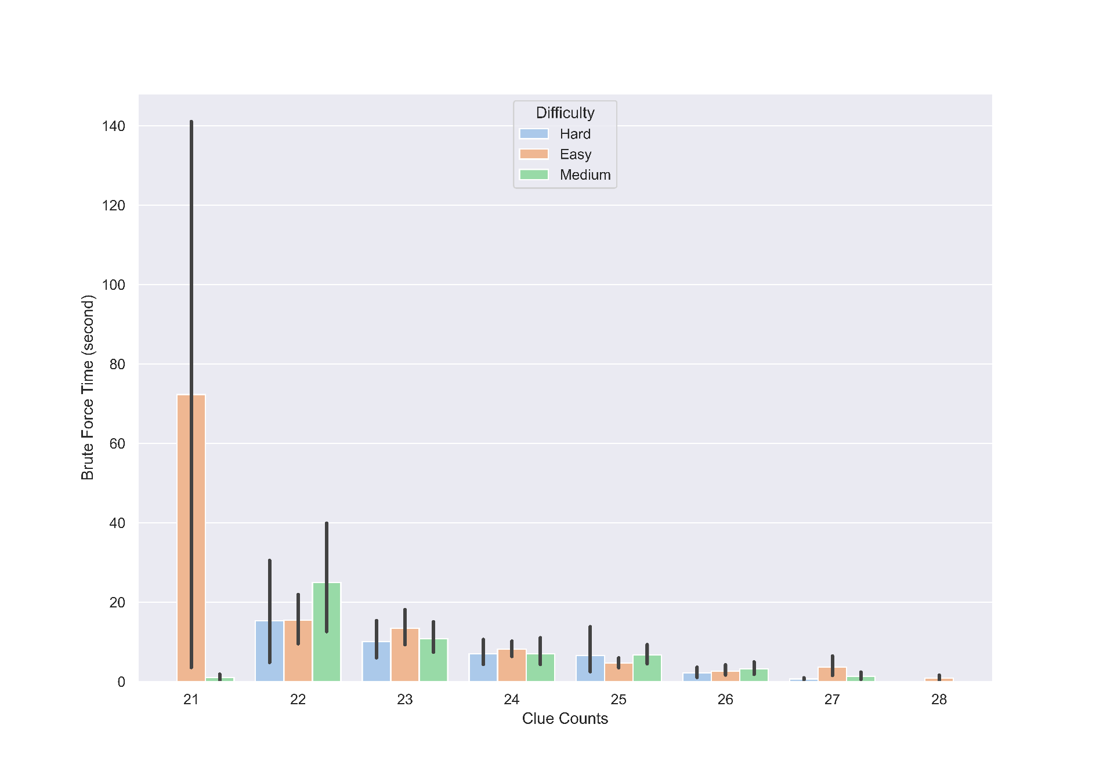
Results (Brute Force)

Slide 18
Conclusion & Discussion
Minimum 17 clue is required to solve a puzzle
The hardness of a puzzle doesn’t depend on clue count
Harder puzzles take more time to solve
Sudoku hardness with respect to symmetry is inconclusive as all puzzles were asymmetric
Hardness of puzzles don't depend on size of vacant regions
For brute force, solving time increases if clue count decreases and time to solve decreases if hole size increases
For logic based solving methods, if clue count increases time to solve increases and time to solve decreases if hole size increases
Human solving techniques need less time to solve puzzle compared to brute force

Slide 19
References
Jussien, Narendra. A to Z of Sudoku. ISTE, 2007.
Rosenhouse, Jason., and Laura Taalman. Taking Sudoku Seriously: The Math Behind the World's Most Popular Pencil Puzzle. Oxford ; New York: Oxford University Press, 2011. Print.
Pelánek, Radek. "Difficulty Rating of Sudoku Puzzles by a Computational Model." FLAIRS Conference. 2011.
Li, Guo, et al. "Genarate and Solve Sudoku Puzzle." 2019 10th International Conference on Information Technology in Medicine and Education (ITME). IEEE, 2019.
Molnár, B., Molnár, F., Varga, M., Toroczkai, Z., & Ercsey-Ravasz, M. (2018). A continuous-time MaxSAT solver with high analog performance. Nature communications, 9(1), 1-12.
McGuire, Gary, Bastian Tugemann, and Gilles Civario. "There is no 16-clue Sudoku: solving the Sudoku minimum number of clues problem via hitting set enumeration." Experimental Mathematics 23.2 (2014): 190-217.

Slide 20
THANK YOU

